Slide 1
HDL 1

Slide 2
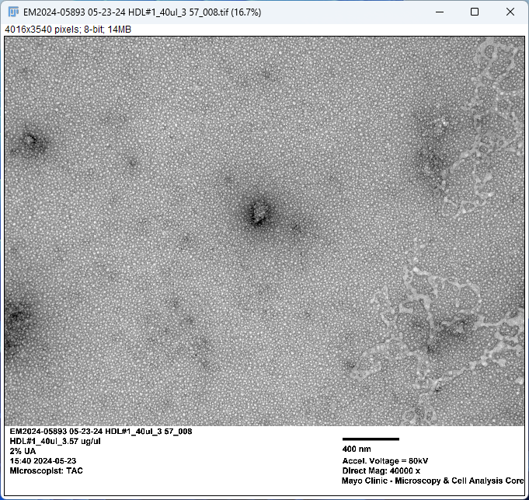
HDL1
Grayscale Image
8-Bit
0 (Dark) - 255 (White)

Slide 3
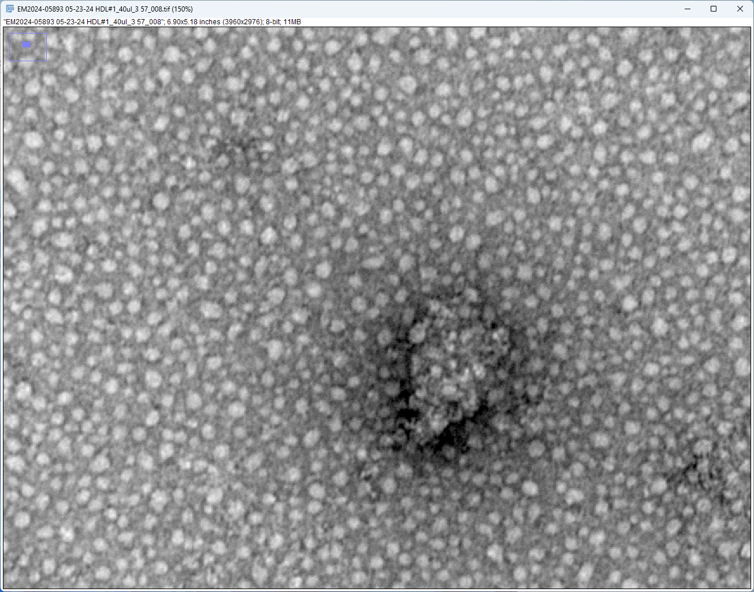
Crop and Zoom

Slide 4
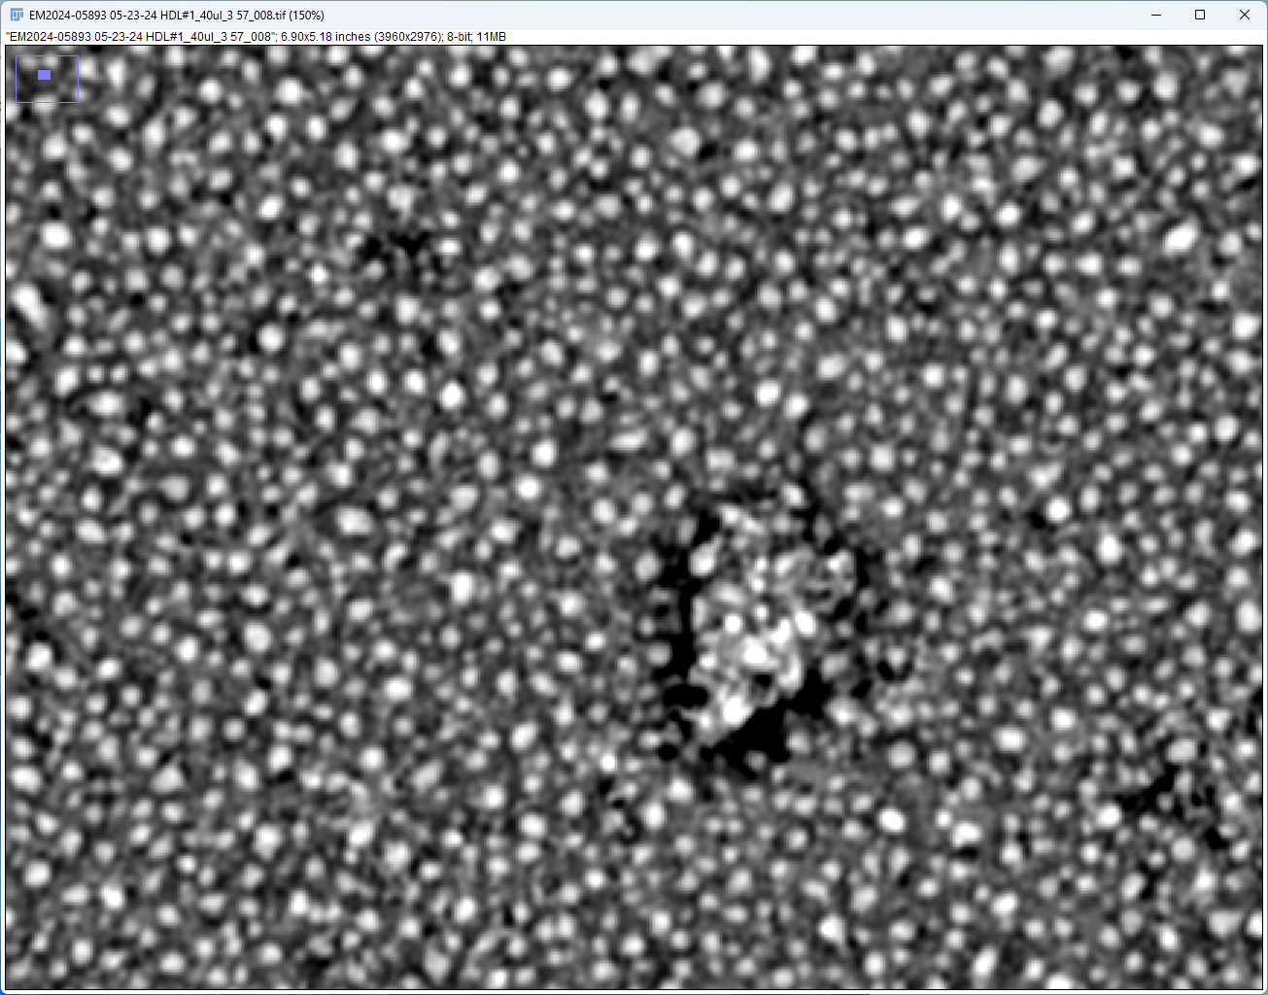
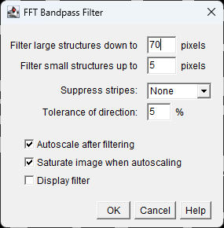

Slide 5
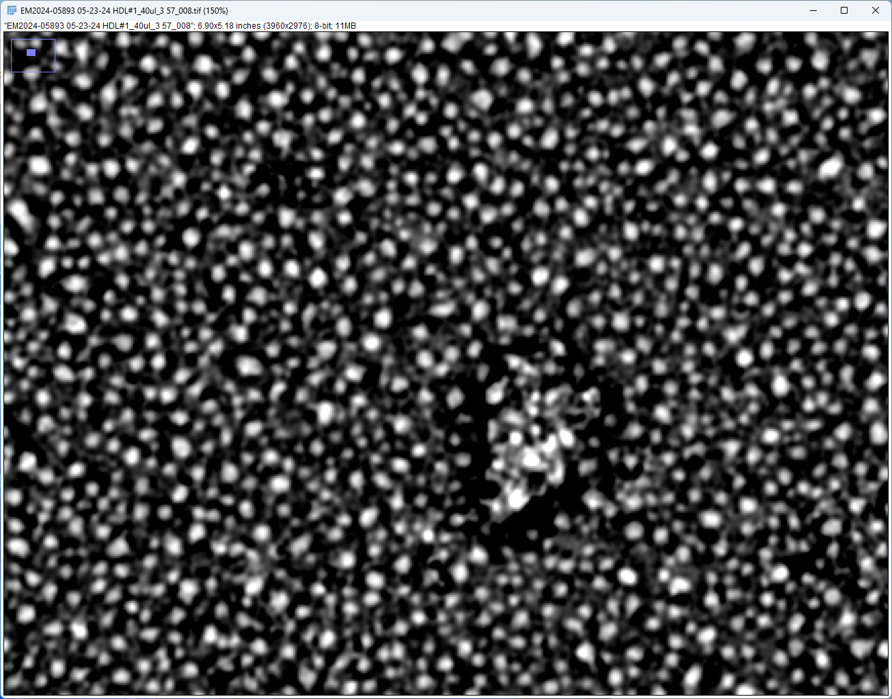
Adjust Contrast

Slide 6
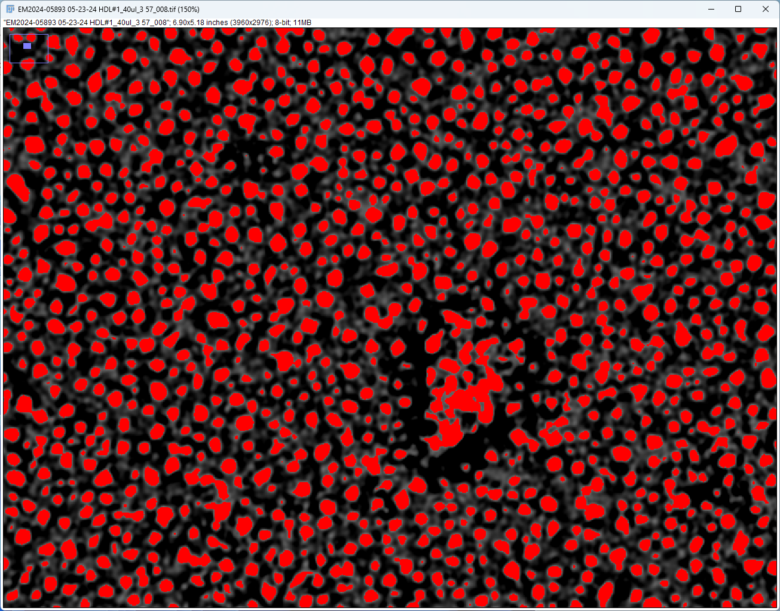
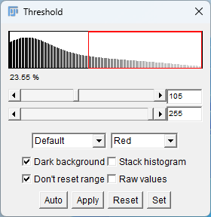

Slide 7
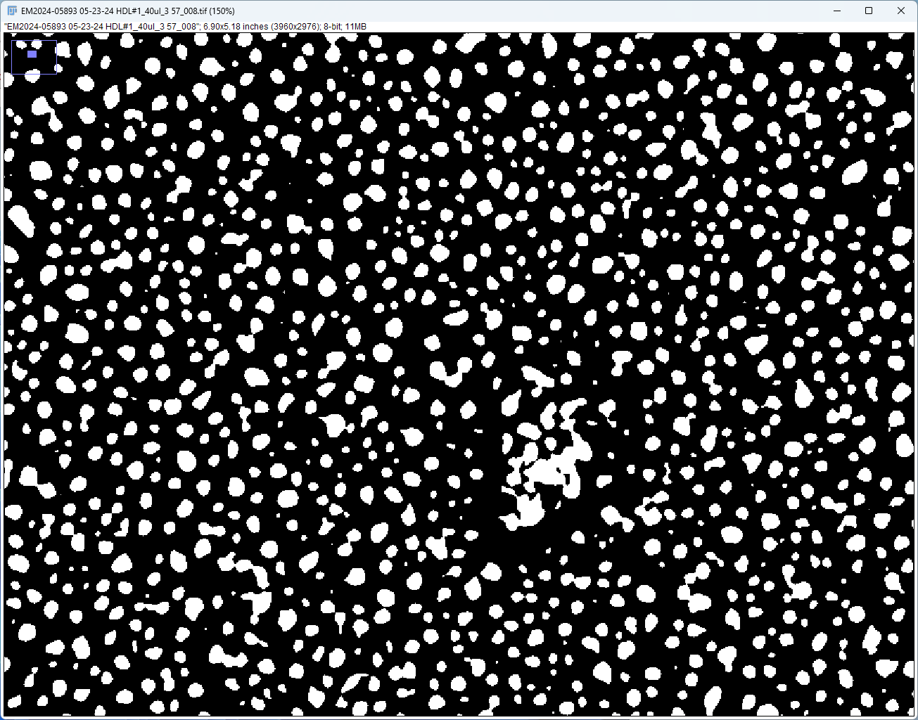
Binary Mask

Slide 8

Fill Holes

Slide 9

Watershed

Slide 10
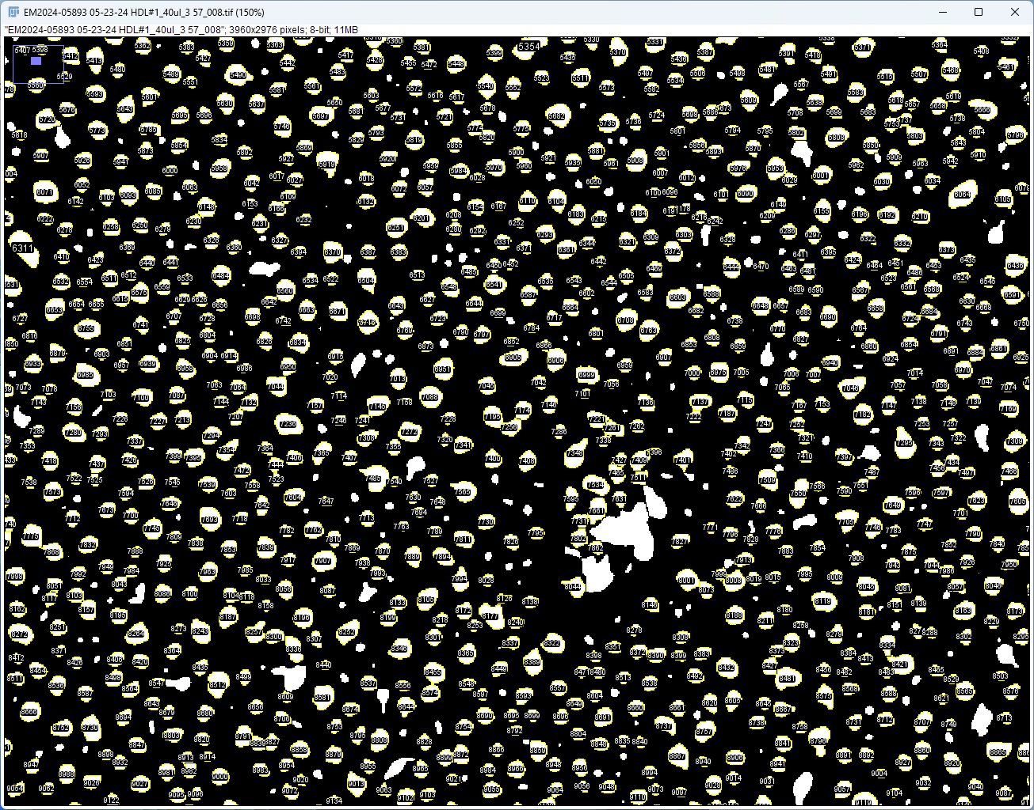
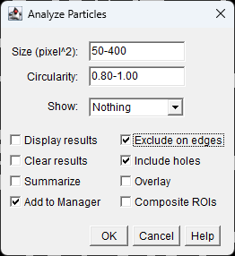

Slide 11
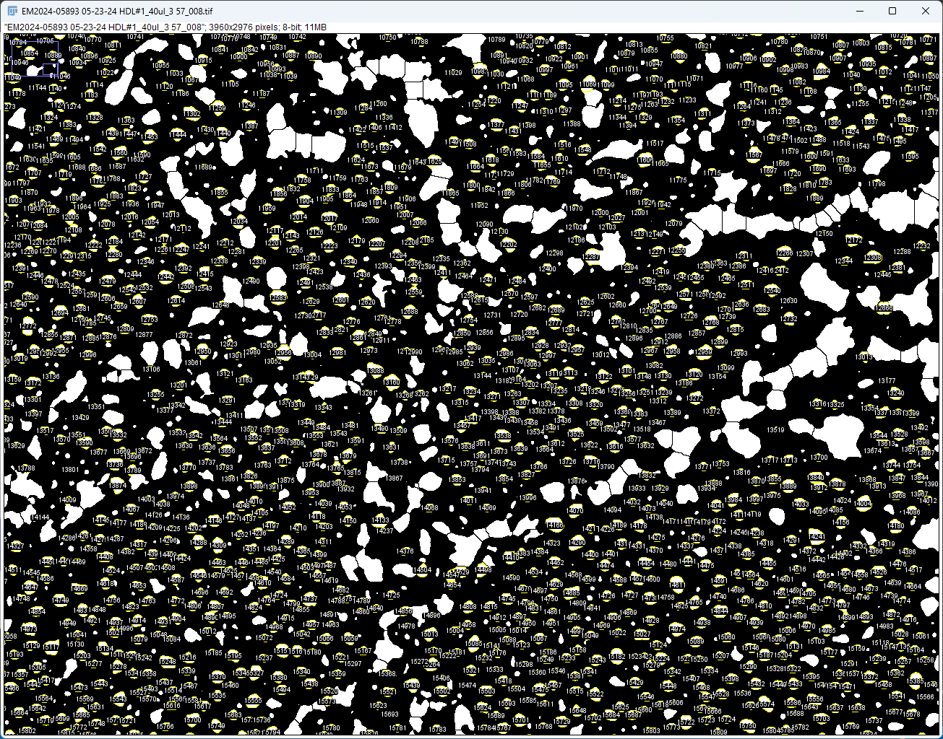

Slide 12
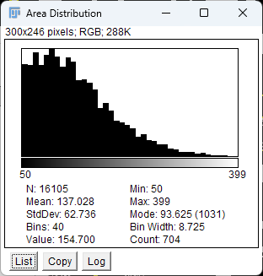
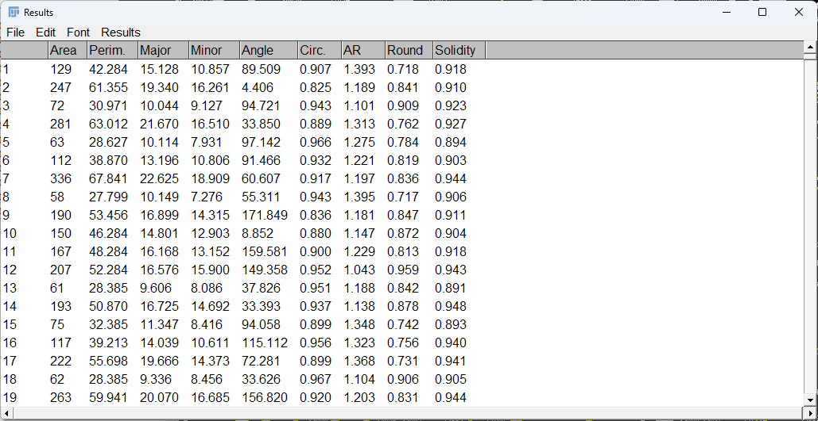

Slide 13
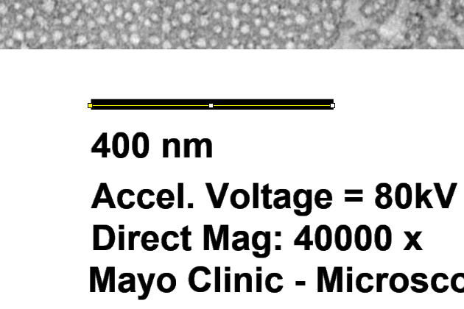
Conversion factor:
440 Pixels / 400 nm

Slide 14
HDL 2

Slide 15
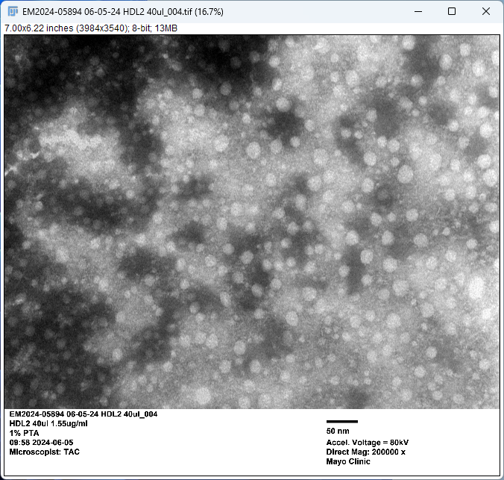
HDL2

Slide 16
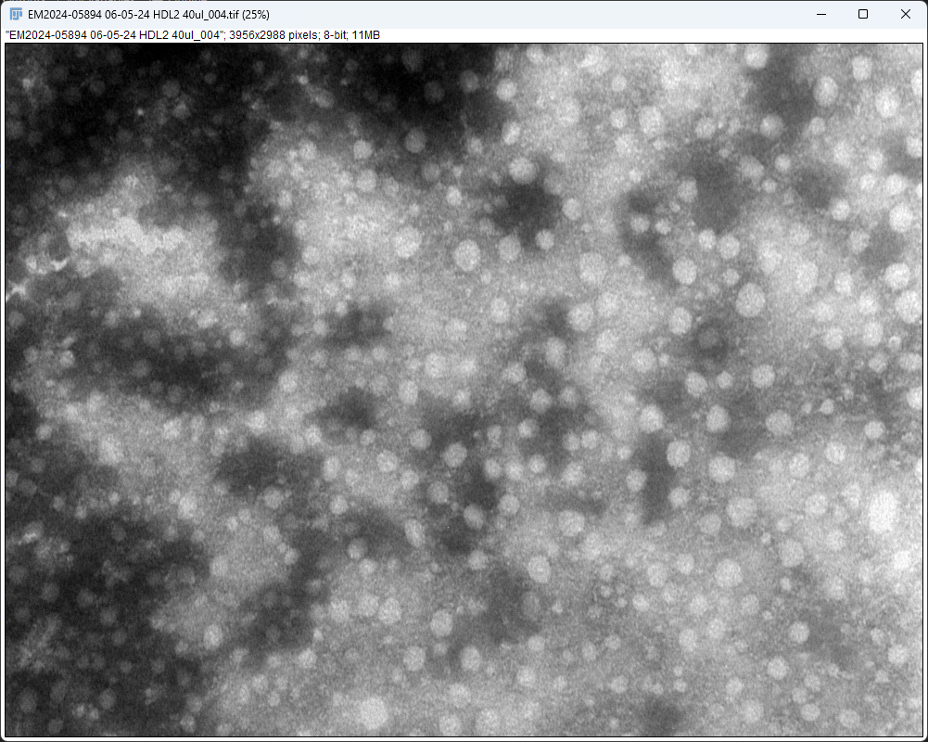
Crop

Slide 17
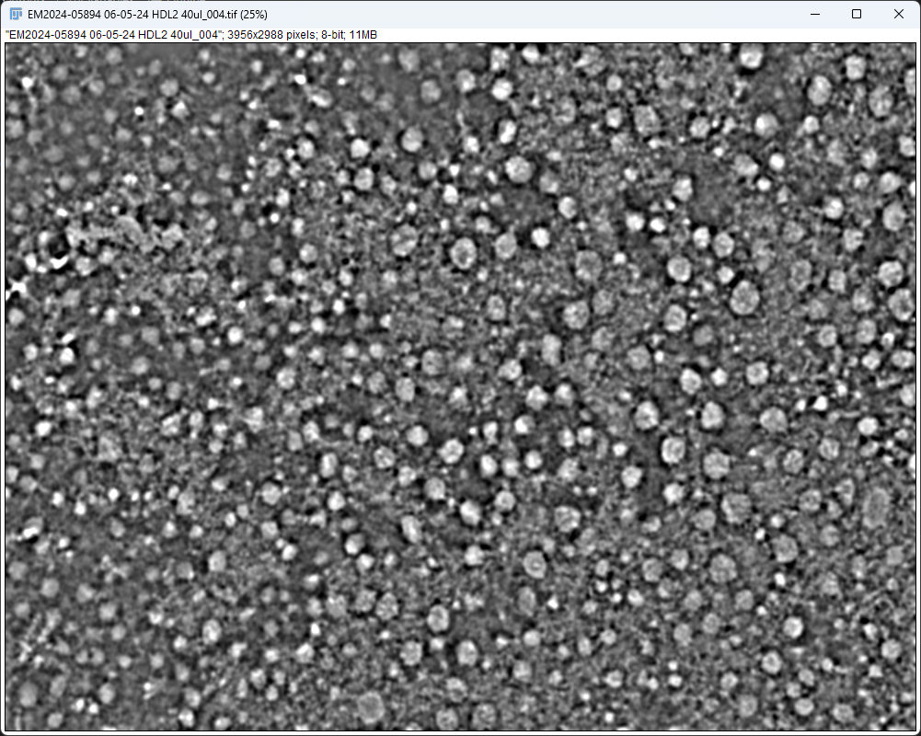
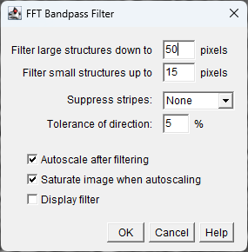

Slide 18
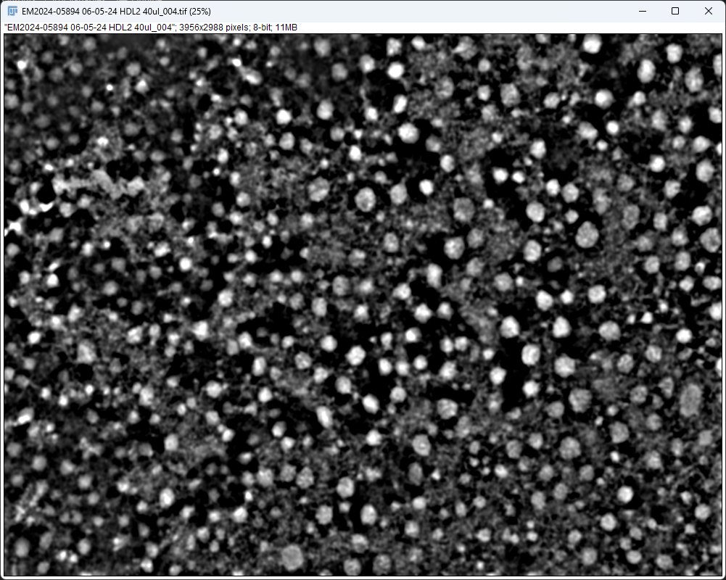


Slide 19
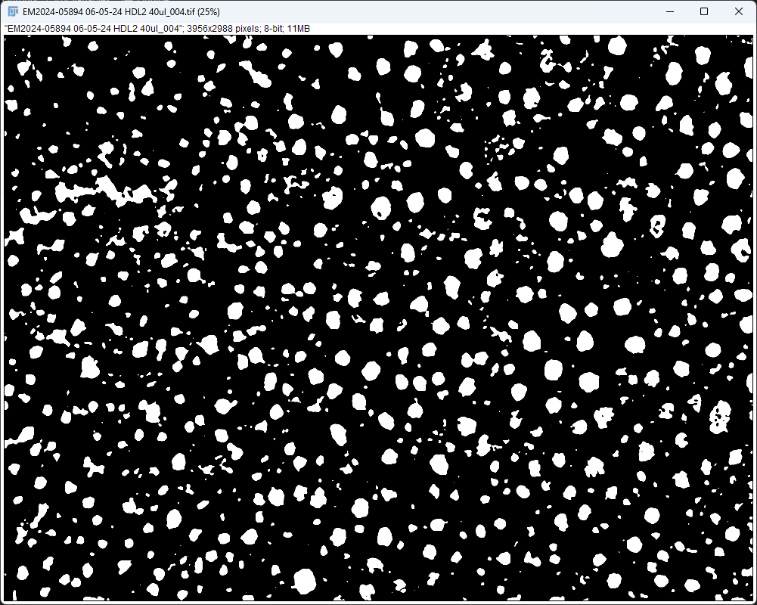

Slide 20
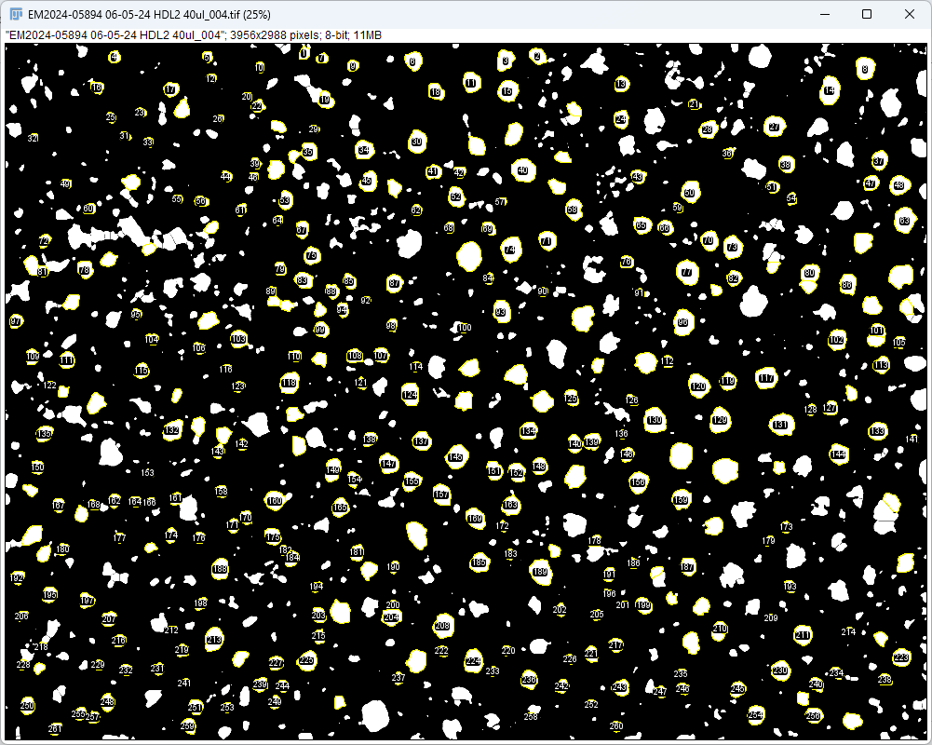
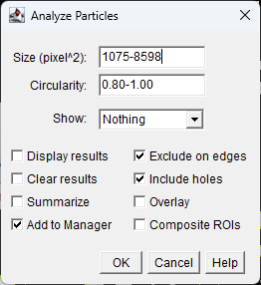
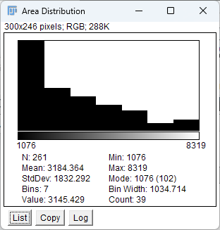

Slide 21
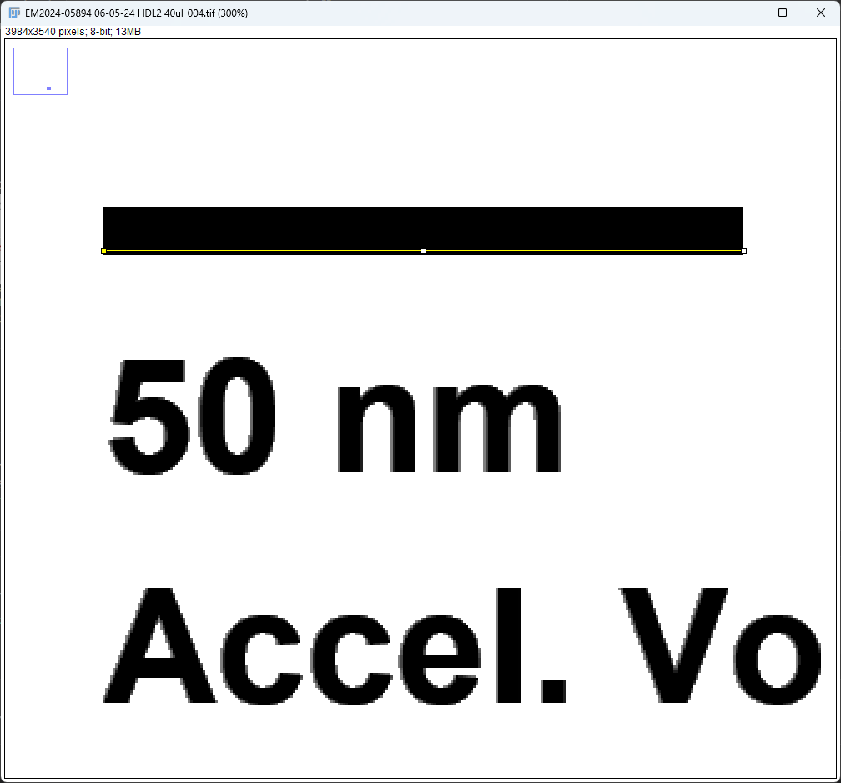
Length = 255 Pixels

Slide 22
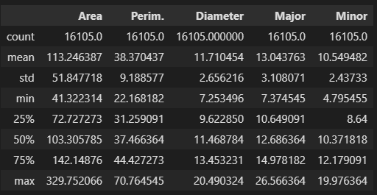
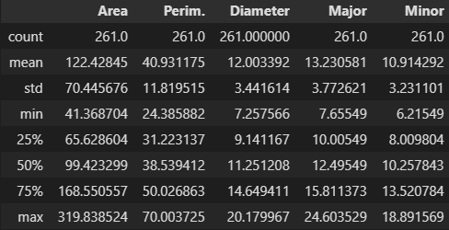
Length unit: nm
Area unit: nm^2
HDL 1
HDL 2

Slide 23
Summary
Measurements were taken under a common size range and a common circularity range
Size range: 41.3 – 330.6 nm^2
Circularity range: 0.8 – 1.0
Non-parametric tests
Mann-Whitney p = 0.80, size distributions do not differ significantly
Kruskal-Wallis p = 0.80, population medians do not differ significantly
Conclusion: No statistical significance in size difference between HDL1&2

